Slide 1
Vision Language Models are Strong Noisy Label Detectors
CSN-300 Lab-based Project
Members:
Anvit Gupta | 22114009
Sarvasva Gupta | 22114086
Supervisor :
Prof. Pravendra Singh

Slide 2
Introduction
Fine-tuning vision-language models for downstream tasks is often hindered by the presence of noisy labels in real-world datasets.
DeFT, a Denoising Fine-Tuning framework that utilizes the robust alignment capabilities of pre-trained models like CLIP to detect and mitigate noisy labels.
DeFT operates in two phases:
Detecting noisy samples via learned textual prompts (Phase 1) and
Fine-tuning on the cleaned dataset for classification (Phase 2).

Slide 3
Our Contributions
Reproduction of Results
Successfully reproduced the results from the paper using the provided codebase.
Achieved consistent precision-recall metrics for noisy label detection and image classification accuracy on the downstream task.
Exploration of Improvements
Investigated the impact of adding Gaussian noise to the dataset.
It didn’t lead to considerable degradation, suggesting that other improvements should be explored.

Slide 4
Our Contributions
Implementation of Pseudo-labelling
Replaced the noisy label removal strategy with pseudo-labelling of the detected noisy samples
Resulted in a noticeable improvement in classification accuracy.
Enhancement of DEFT Framework
Demonstrated that incorporating pseudo labelling can improve the DEFT framework’s performance in practical applications, especially in scenarios with noisy labels.

Slide 5
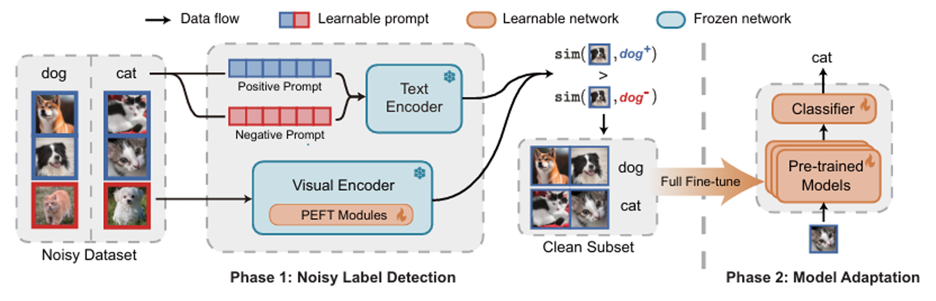
DeFT Framework
Overview of the DEFT framework. Phase 1 identifies noisy labels using dual
textual prompts and PEFT modules. Phase 2 adapts the model using FFT on clean samples selected from Phase 1.

Slide 6
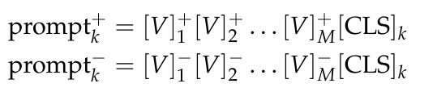
Phase 1: Identifying Noisy Labels with Dual Prompts (PEFT)
The naive approach involves labeling samples as "clean" if there is a strong alignment between their visual and textual features.
However, this naive strategy requires noise ratio estimates or manual thresholds. To overcome this limitation, we adopt a dual-prompt design.

Slide 7

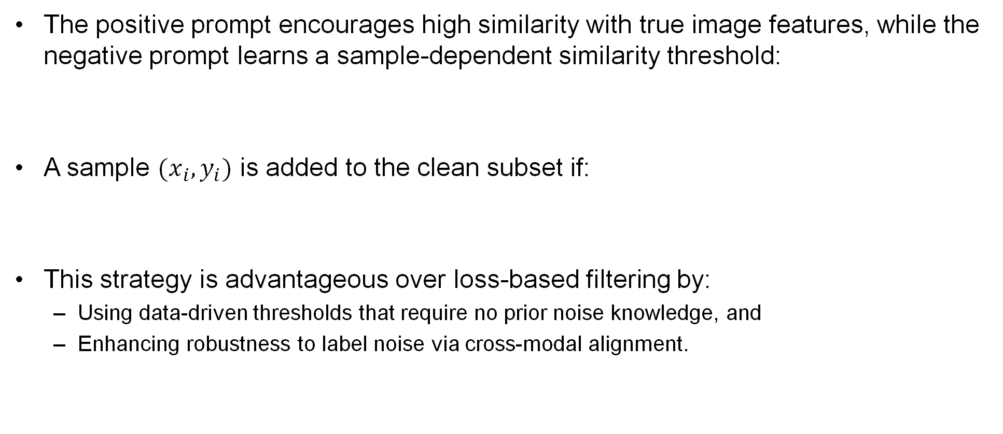
Phase 1: Identifying Noisy Labels with Dual Prompts (PEFT)
The positive prompt encourages high similarity with true image features, while the negative prompt learns a sample-dependent similarity threshold:
A sample $(x_{i},y_{i})$ is added to the clean subset if:
This strategy is advantageous over loss-based filtering by:
Using data-driven thresholds that require no prior noise knowledge, and
Enhancing robustness to label noise via cross-modal alignment.

Slide 8
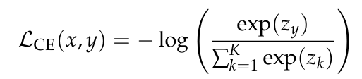
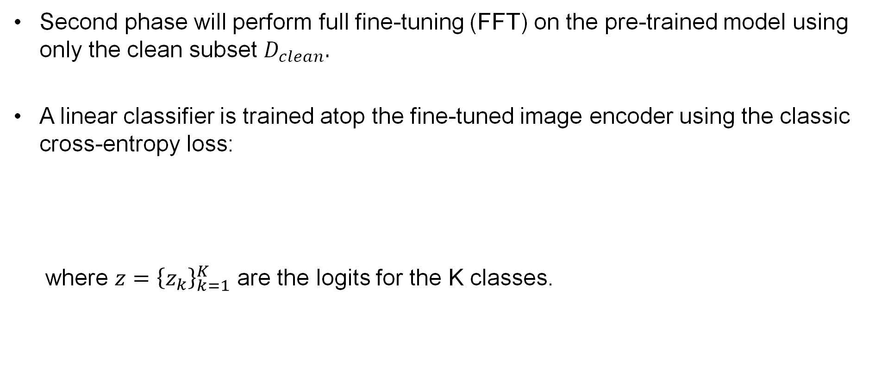
Phase 2: Model Adaptation on Clean Data (FFT)
Second phase will perform full fine-tuning (FFT) on the pre-trained model using only the clean subset $D_{clean}.$
A linear classifier is trained atop the fine-tuned image encoder using the classic cross-entropy loss:
where $z={\left\{z_{k}\right\}}_{k=1}^{K}$ are the logits for the K classes.

Slide 9
Datasets Used
DeFT is evaluated on synthetic datasets like CIFAR-100, Tiny-ImageNet, and Stanford-Cars, CUB-200-2011.
Two types of label noise are introduced: symmetric (sym) and instance-dependent (ins) noise.
Noise ratios for symmetric noise are r ∈ {0.2, 0.4, 0.6}, and for instance-dependent noise, r ∈ {0.2, 0.3, 0.4}.
Real-world datasets tested include CIFAR-100N, Clothing1M, and WebVision with noisy labels.

Slide 10
Implementation Details
The approach uses a pre-trained CLIP model with a Transformer-based text encoder and ViT-B/16 image encoder.
Training is performed using SGD with momentum 0.9, weight decay 5 × 10^−4, and a batch size of 64 for 10 epochs.
Visual Prompt Tuning (VPT) and Context Optimization (CoOp) are applied to adapt the image and text encoders.
A 1-epoch warm-up phase is used across all datasets to stabilize training.
Evaluation metrics include precision and recall for clean sample selection, and best/final test accuracy for image classification performance.

Slide 11
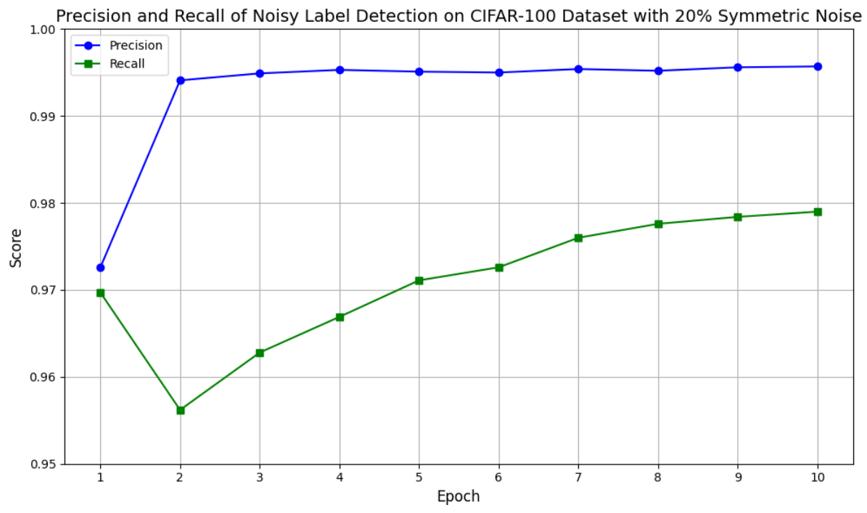
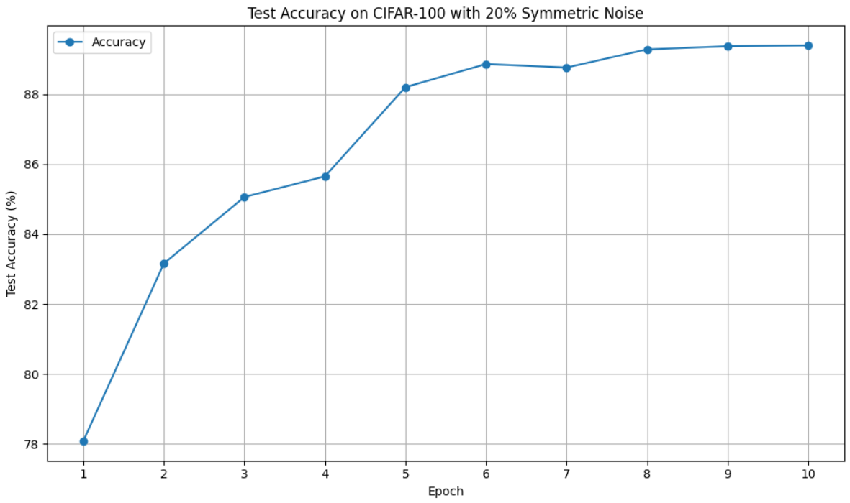
Reproduced Results

Slide 12
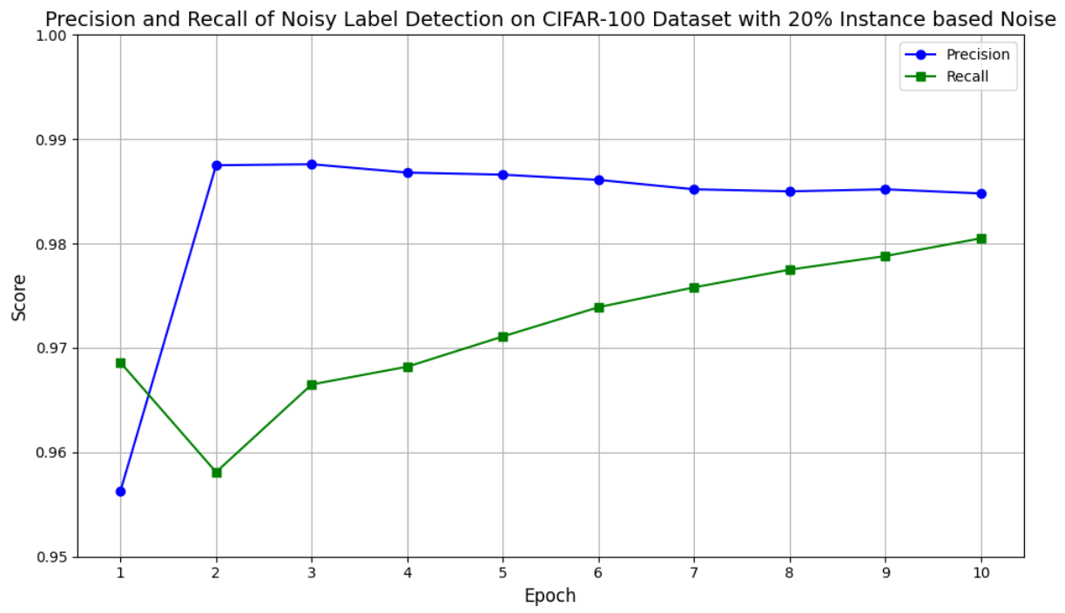
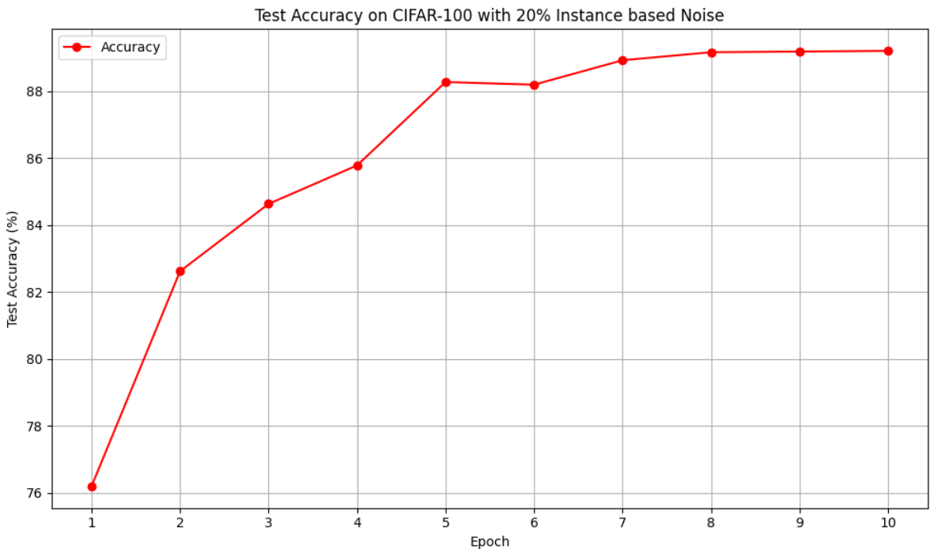
Reproduced Results

Slide 13
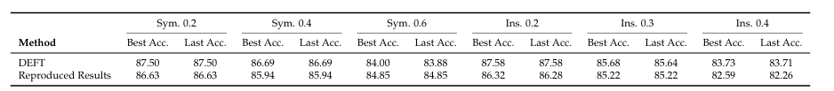
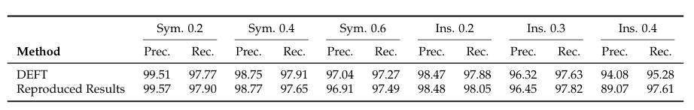
Reproduced Results
Comparison of Best and Last classification accuracies under different symmetric and instance-dependent noise ratios on CIFAR-100 Dataset
Comparison of Precision and Recall of Noisy-Label Detection under different symmetric and instance-dependent noise ratios on CIFAR-100.

Slide 14
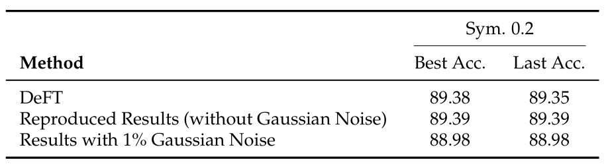
Explored Improvements
Controlled Gaussian noise is added to training and/or testing data to assess input-level corruption effects.
The model shows strong robustness, with minimal performance drop even under 1% training noise.
Best and Last Accuracies on CIFAR-100 Dataset after adding Gaussian Noise to the Dataset

Slide 15
Explored Improvements
The proposed DeFT framework discards noisy labels during training.
Instead of discarding, these samples can be leveraged to enhance performance.
This is achieved through pseudo-labeling using a vision-language model like CLIP.

Slide 16
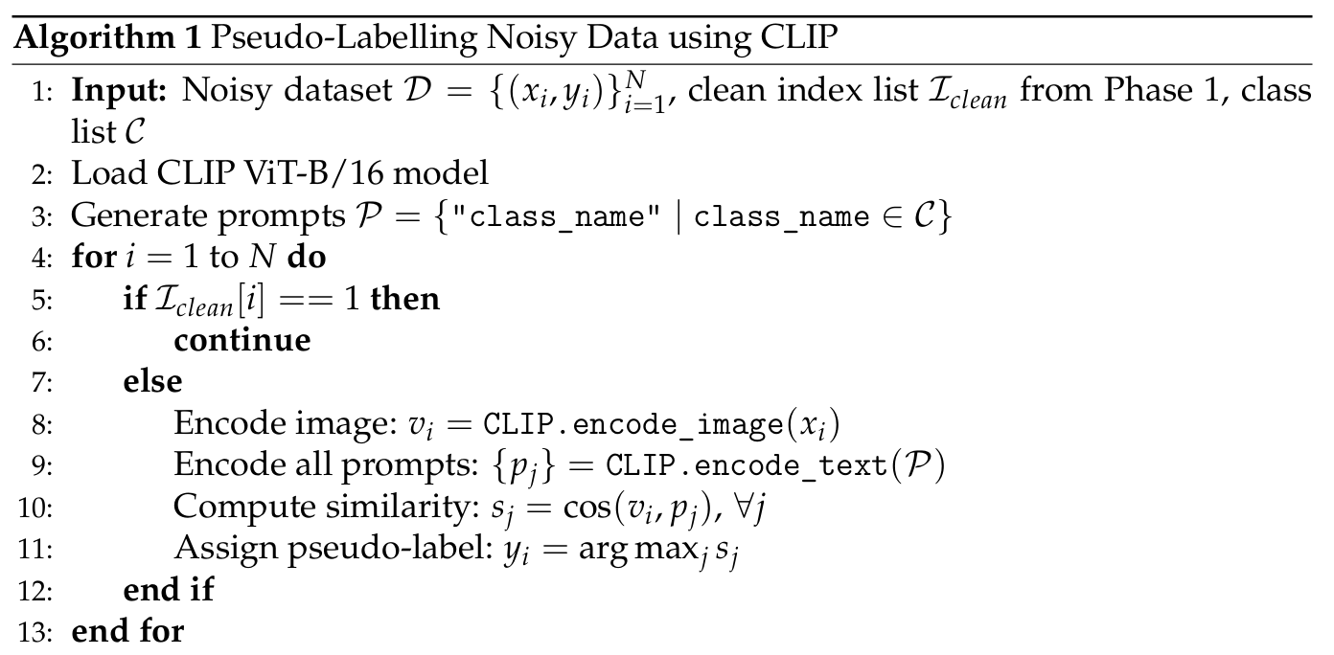
Pseudo-Labeling Algorithm

Slide 17
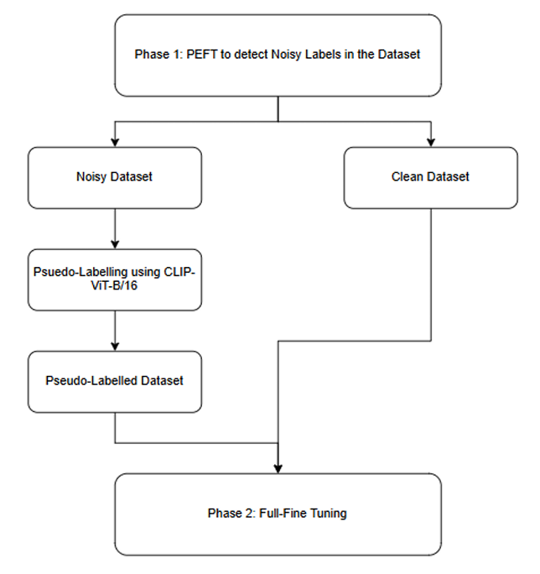
Modified DeFT Framework
Phase 1: Performs binary classification to identify noisy samples using Parameter-Efficient Fine-Tuning (PEFT).
Clean samples are retained without modification.
Noisy samples are re-labeled through a pseudo-labeling strategy.
Phase 2: Full fine-tuning is conducted on the combined clean and pseudo-labeled dataset.

Slide 18
Datasets Used and Implementation Details
The experiment was conducted on the CIFAR-100 dataset with 20% symmetric label noise.
Implementation was performed using Google Colab with a free GPU.
The objective was to assess the effect of pseudo-labeling on classification accuracy.
Accuracy was used as the primary metric to evaluate noise handling and performance gains.

Slide 19



Pseudo-Labeling Examples
Pseudo-labeled as "apple" by CLIP-ViT-B/16
Pseudo-labeled as "boy" by CLIP-ViT-B/16
Pseudo-labeled as "train" by CLIP-ViT-B/16

Slide 20
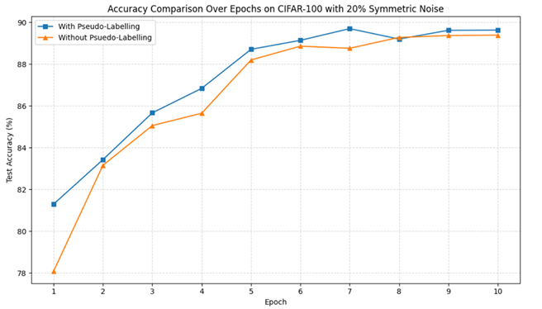
Image Classification Accuracy Comparison
Comparison of Image Classification Accuracy with and without Pseudo-Labeling over the 10 Training epochs

Slide 21
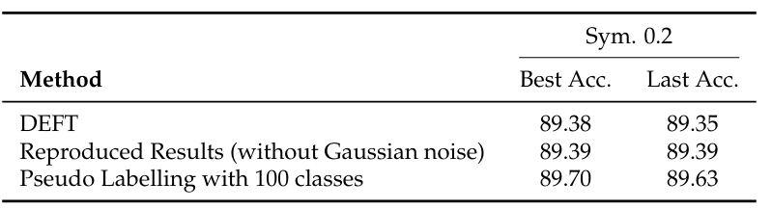
Best and Last Accuracy Report
Final Accuracy Comparison under symmetric noise ratio 0.2 on CIFAR-100

Slide 22
Future Works
Noisy Label Detection in Presence of Input Noise
Develop a framework for noisy label detection in datasets affected by Gaussian input noise.
Address both input-level and label-level noise to enhance model robustness in real-world scenarios.
Exploration of Pseudo-Labelling Strategies
Explore diverse pseudo-labelling strategies, including confidence-based and entropy-based methods.
Aim to identify effective techniques for improving accuracy in semi-supervised learning with noisy labels.

Slide 23
References
Wei, H., Wang, H., & Lipton, Z. C. (2024). Vision-Language Models are Strong Noisy Label Detectors. Available at: [2409.19696] Vision-Language Models are Strong Noisy Label Detectors
DeFT Official Implementation — GitHub Repository. Available at: https://github.com/HotanLee/DeFT
OpenReview — Open Peer Review Platform for Machine Learning Conferences. Available at: https://openreview.net/
NeurIPS — Conference on Neural Information Processing Systems. Available at: https://neurips.cc/
ICLR — International Conference on Learning Representations. Available at: https://iclr.cc/
CVPR 2025 — IEEE/CVF Conference on Computer Vision and Pattern Recognition. Available at: https://cvpr.thecvf.com/Conferences/2025

Slide 24
Thank You

